Slide 2
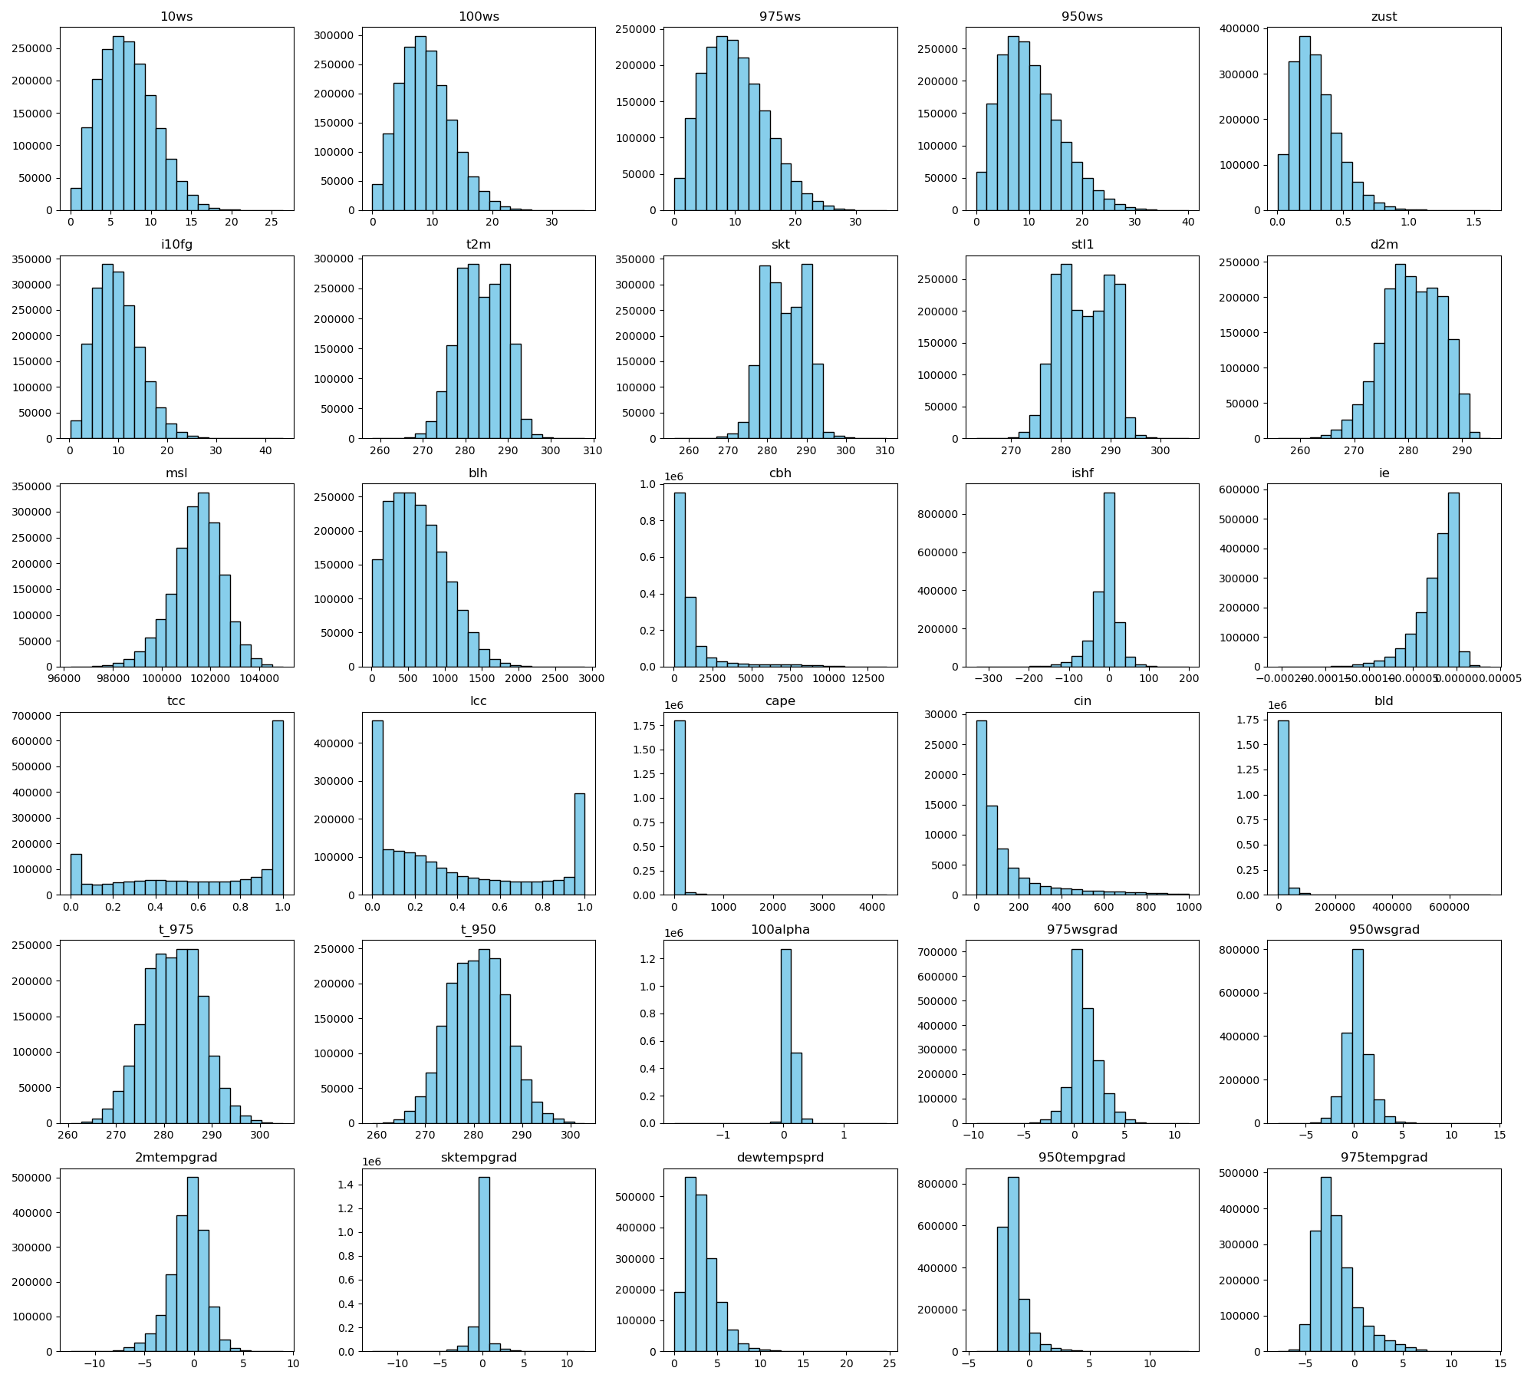
Distributions of input meteorological variables

Slide 3
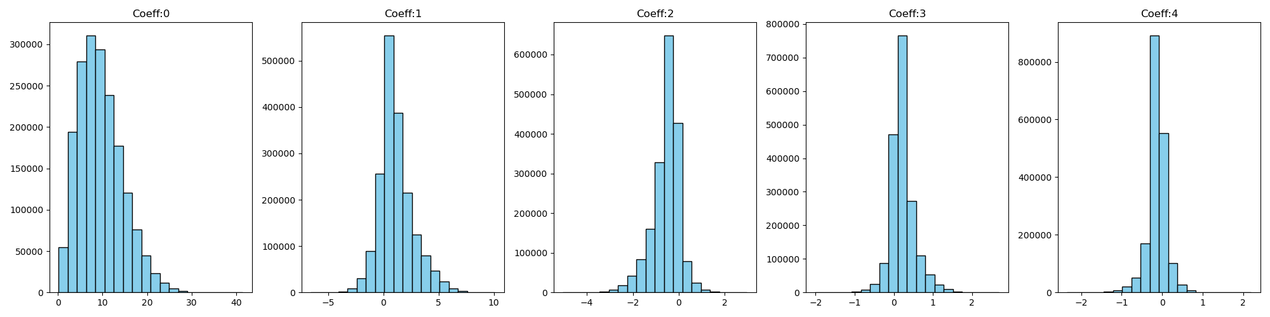
Distributions of Target coefficients

Slide 4
Data processing
Location: Fino1
Input variables: 30 (meteorological variables)
Target variables: 5 (C0 to C1)
Training dates range: 2000-01-01T00 to 2000-12-31T21 (Total 8784 time instances)
Validation split: random six consecutive days of each month (1728 time instances)
Training split: Remaining of validation split (7056 time instances)
Testing data: 2001-01-01T00 to 2001-12-31T21 (Total 8760 time instances)

Slide 5
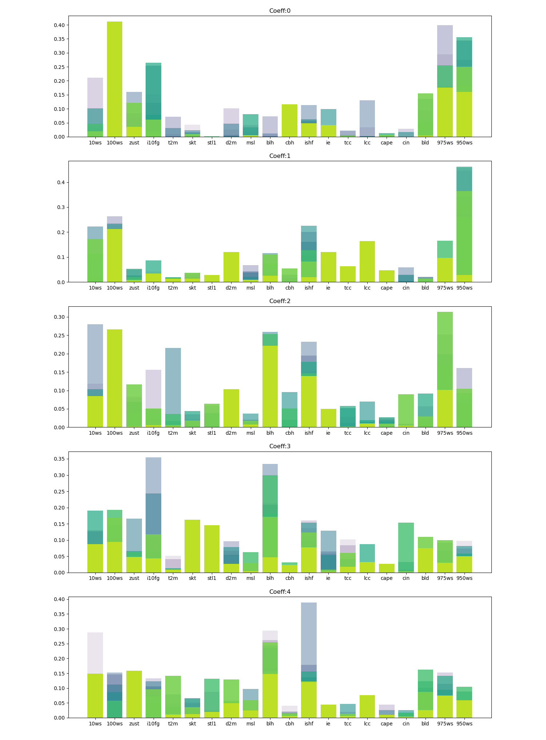
Experiment 1: Tabnet
10 ensembles, 100 trials, and 20 input variables (raw), single output training

Slide 6
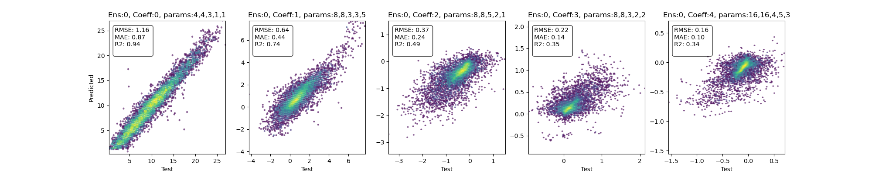
Experiment 2: Tabnet
1 ensemble run, 100 trials, and 29 input variables (raw + derived), single output training

Slide 7
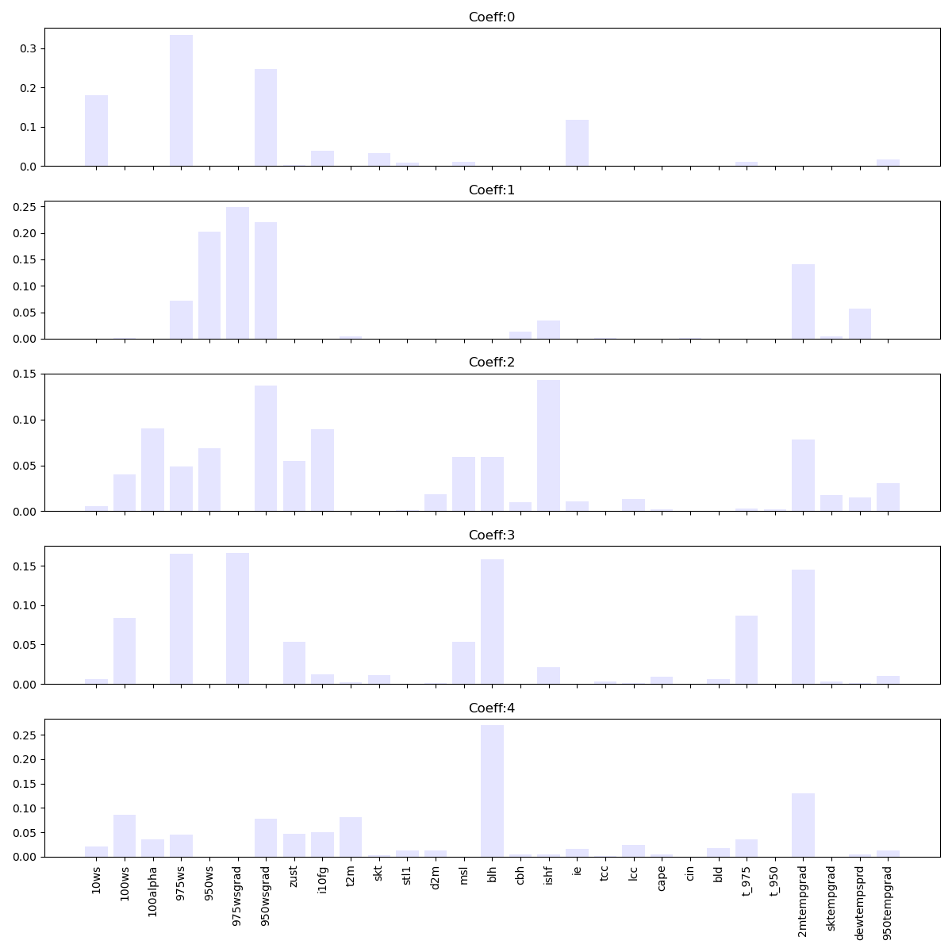
Experiment 2: Tabnet
1 ensemble run, 100 trials, and 29 input variables (raw + derived), output training

Slide 8
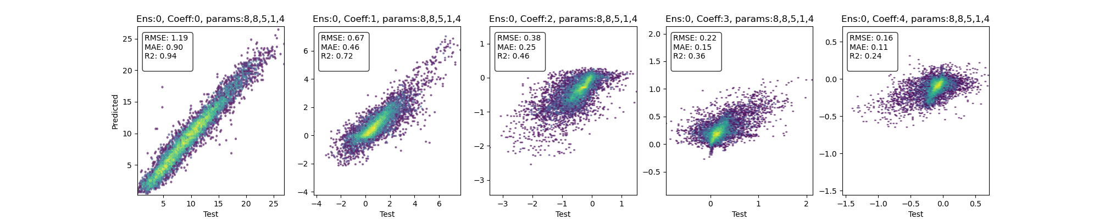
Experiment 3: Tabnet
1 ensemble run, 100 trials, and 30 input variables (raw + derived), multioutput training

Slide 9
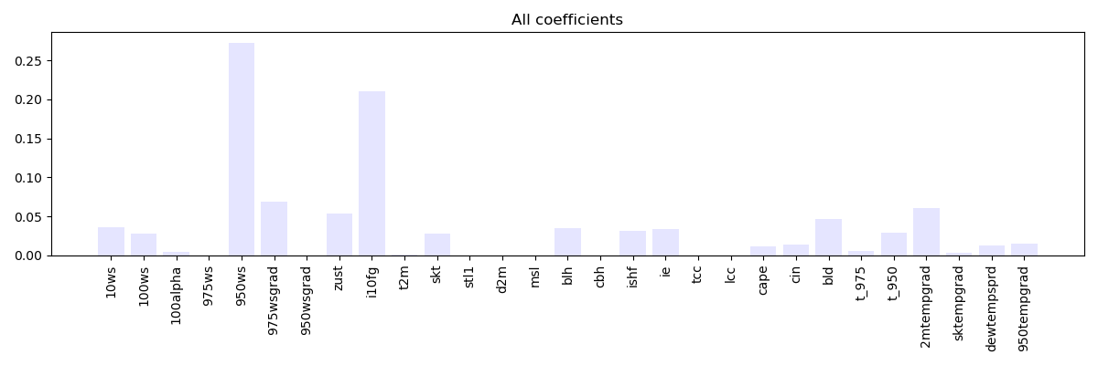
Experiment 3: Tabnet
1 ensemble run, 100 trials, and 29 input variables (raw + derived), multioutput training

Slide 10
AUTOML
Location: Fino1
Input variables: 30 (meteorological variables)
Target variables: 5 (C0 to C1)
Training dates range: 2000-01-01T00 to 2000-12-31T21 (Total 8784 time instances)
Implicit 5-fold cross-validation while training
Testing data: 2001-01-01T00 to 2001-12-31T21 (Total 8760 time instances)

Slide 11
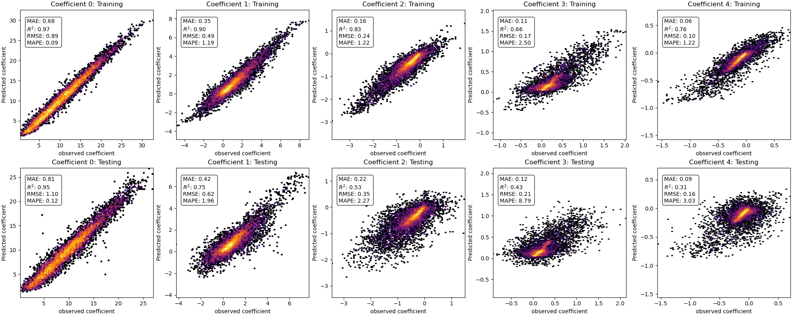
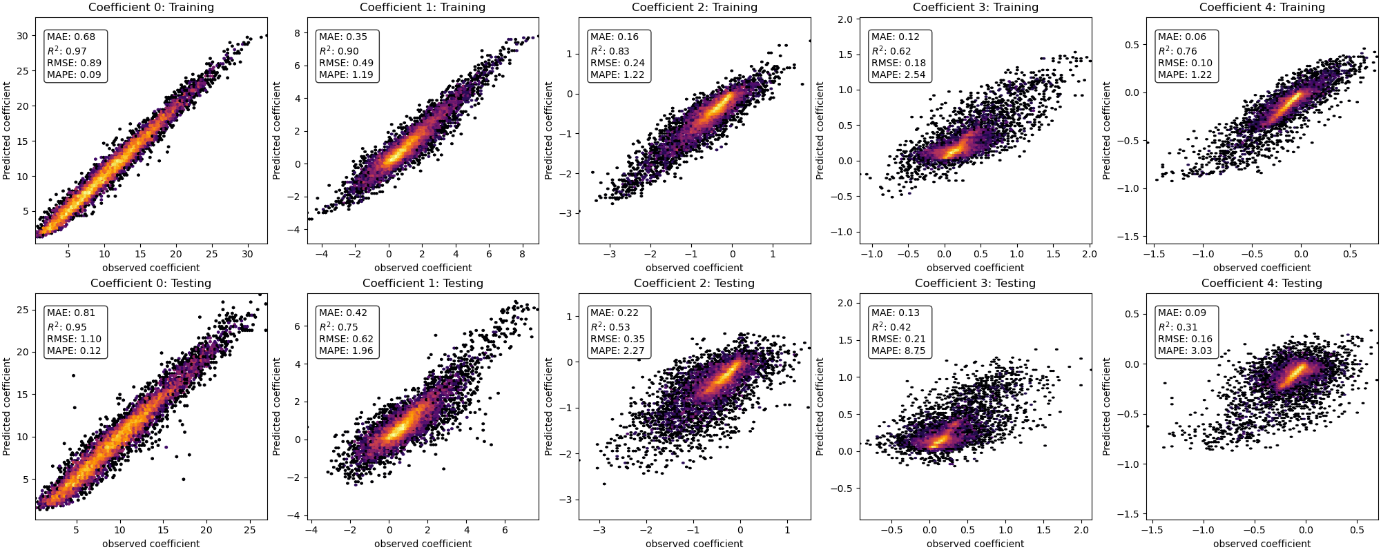
Experiment 4: Automl
30 input variables (raw + derived), single output training
30 input variables (raw + derived), multi output training

Slide 12
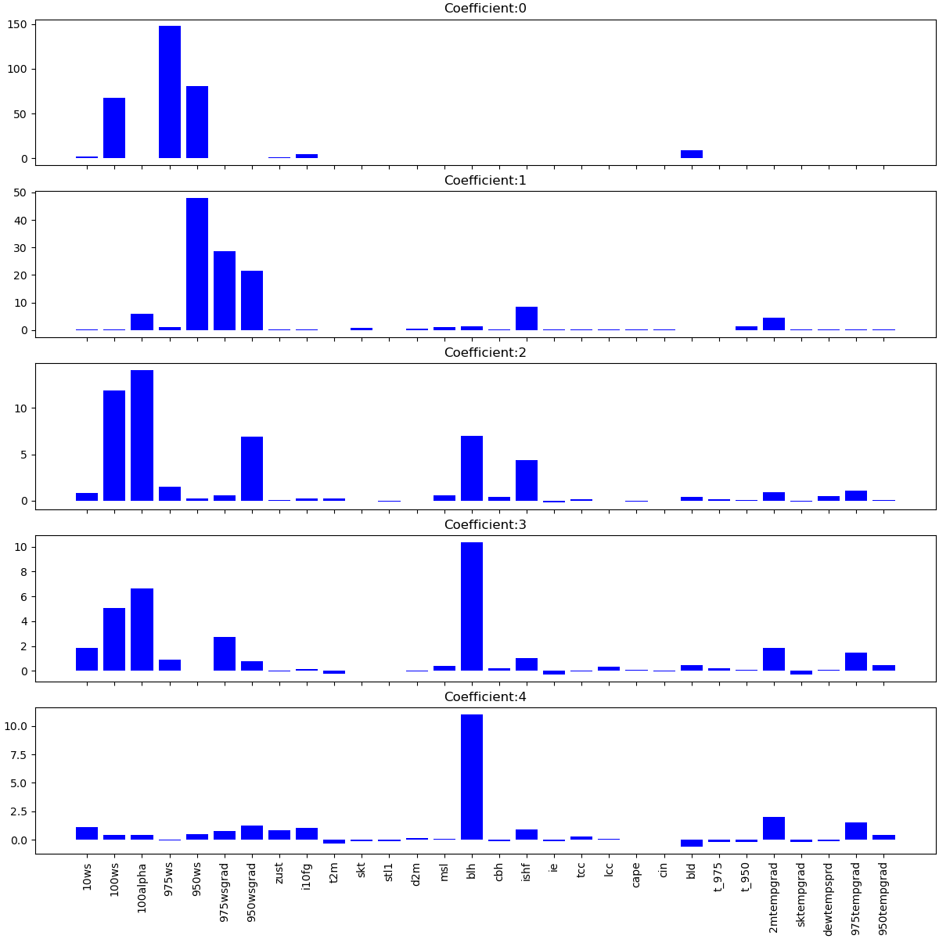
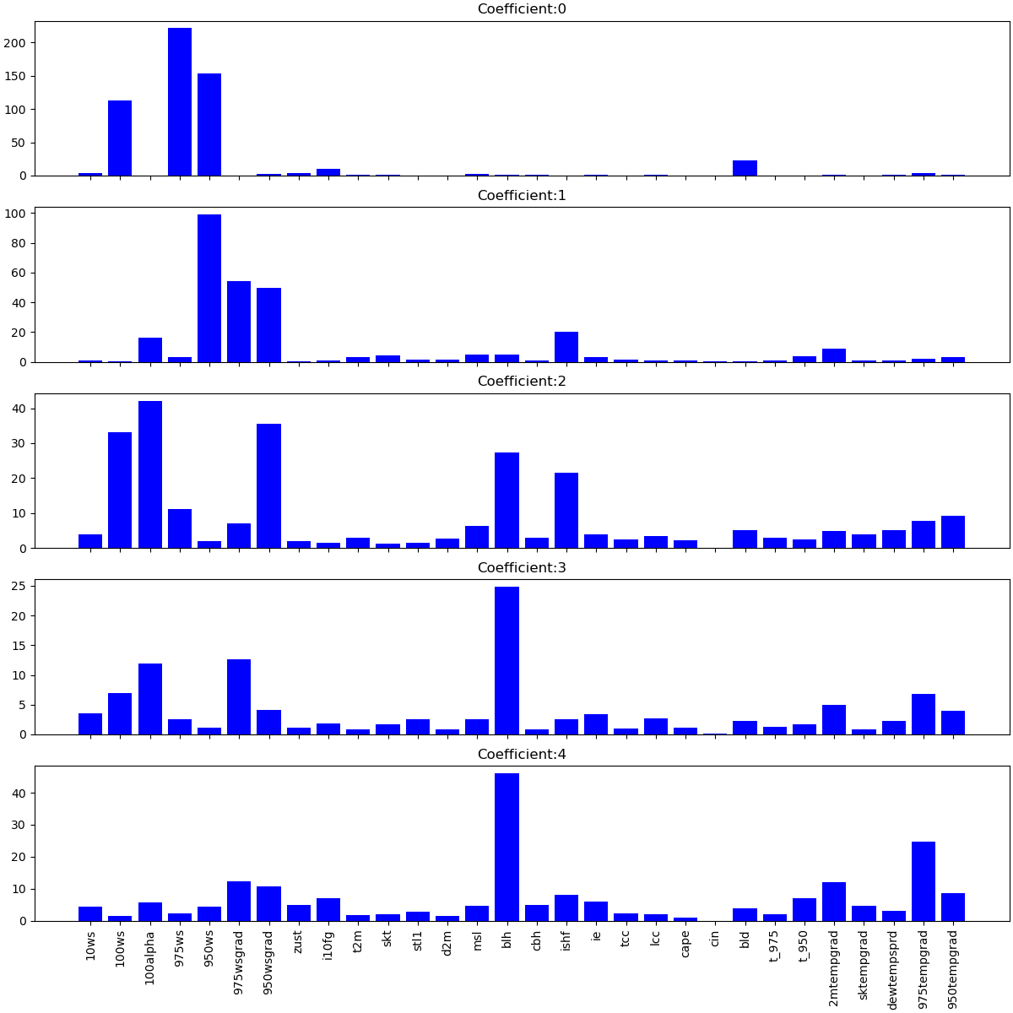
Experiment 4: Automl
30 input variables (raw + derived), single output training
30 input variables (raw + derived), multi output training

Slide 13
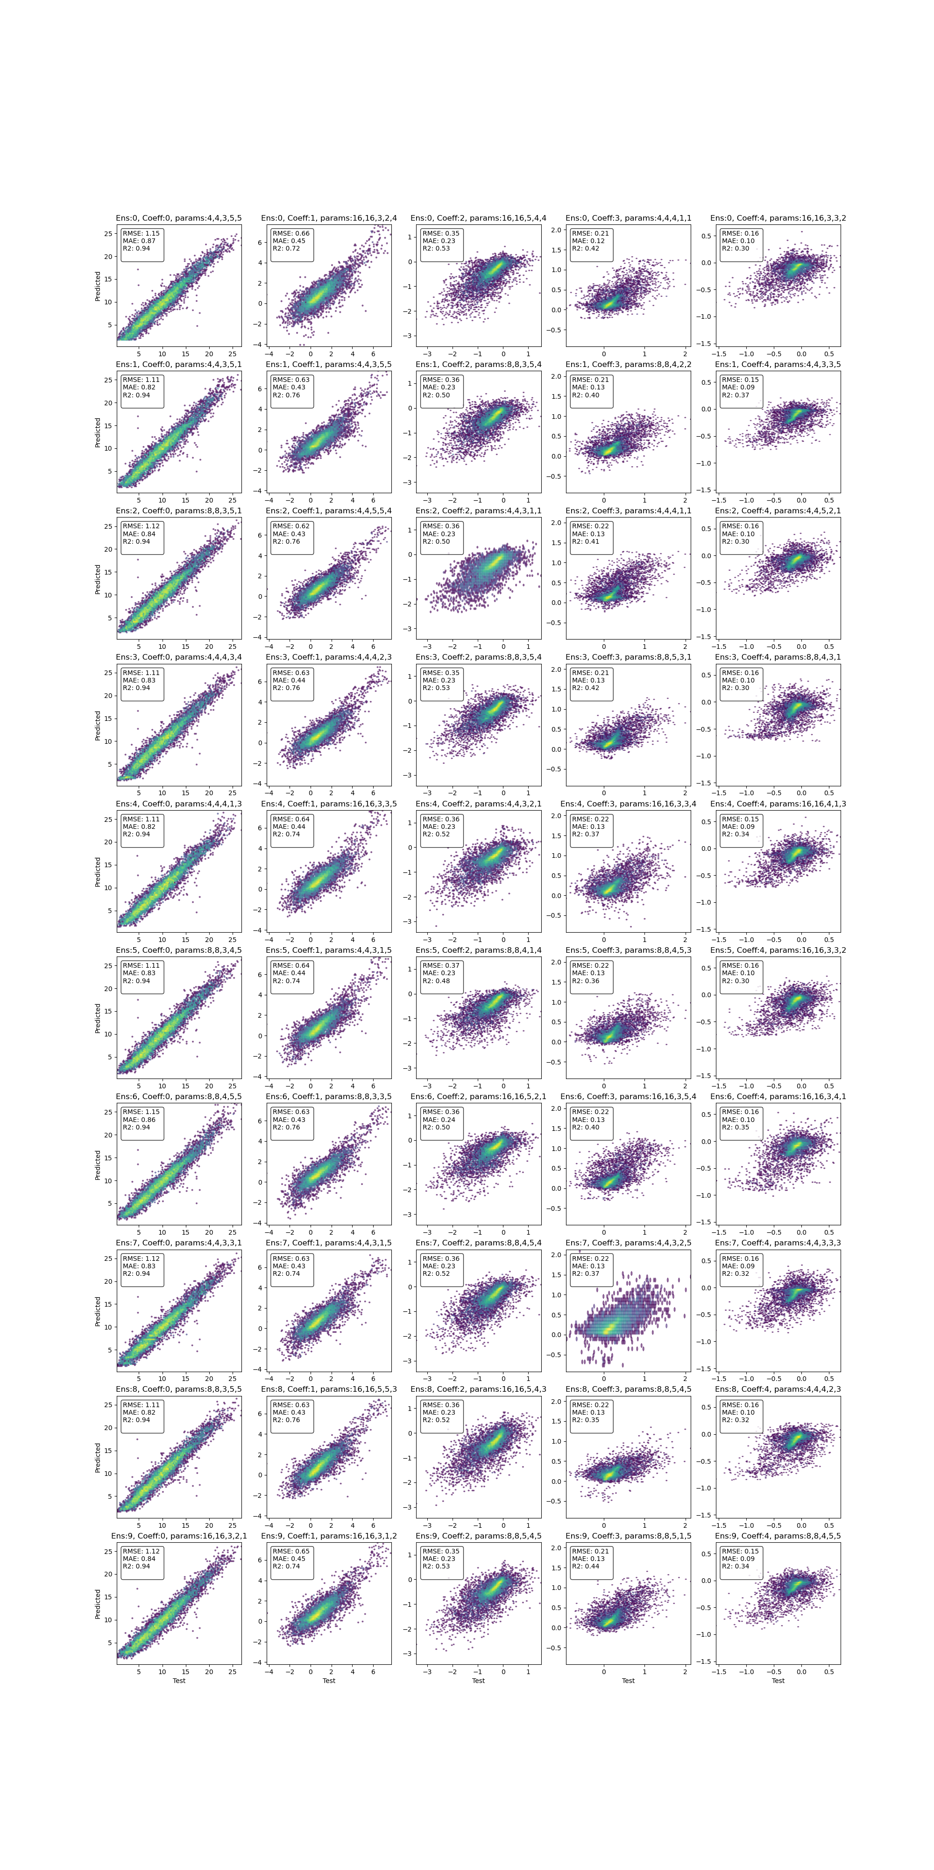
Experiment 4: Tabnet
10 ensemble runs, 100 trials, and 10 input variables (different for each target) (raw + derived) obtained through feature importance, single output training

